Slide 1

AI Chatbot
Rungta College OF Engineering and Technology
Under Guidance of
Ashutosh Sir

Slide 2




Meet our team
Satyam Kumar
Ashish Vishwakarma
Ashish Chandravanshi
Shivam Kumar

Slide 3
Agenda
Abstract
Tools and Libraries
Steps Involved
Code breakdown
Automation in action
Presentation Title

Slide 4

Abstract
Overview of the automation script
Purpose: Automate responses in a chat application using Python
Technologies used: PyAutoGUI, Pyperclip, OpenAI API

Slide 5


Tools & Libraries
PyAutoGUI: Automates GUI interactions
Pyperclip: Handles clipboard operations
OpenAI API: Generates chatbot responses
Time Module: Adds delays for smooth execution

Slide 6
1. Open chat application 2. Copy latest chat messages 3. Analyze sender and message history 4. Generate a witty response using OpenAI 5. Paste and send the response
Steps Involved

Slide 7


Introduction to OpenAI API & API Keys
What is OpenAI API?
OpenAI API provides access to powerful language models like GPT-3.5 and GPT-4.
Used for various NLP tasks such as chatbots, text generation, and more.
What are API Keys?
API keys are unique credentials that allow secure access to OpenAI's services.
Required for authentication when making API requests.
Should be kept confidential to prevent unauthorized use.

Slide 8
Code Breakdown
Clicking on the chat window using PyAutoGUI
Selecting and copying the latest messages
Checking if the last message is from a specific sender
Generating a response with OpenAI API
Pasting and sending the response

Slide 9
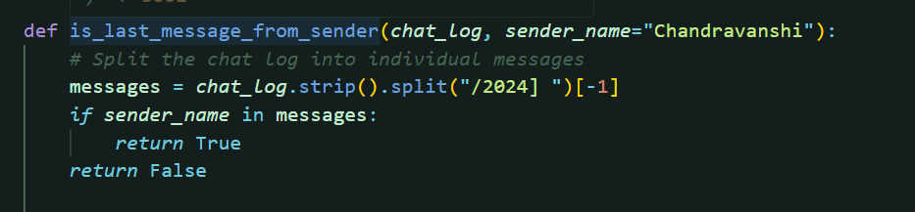
Key Code Snippets
Checking last sender:

Slide 10
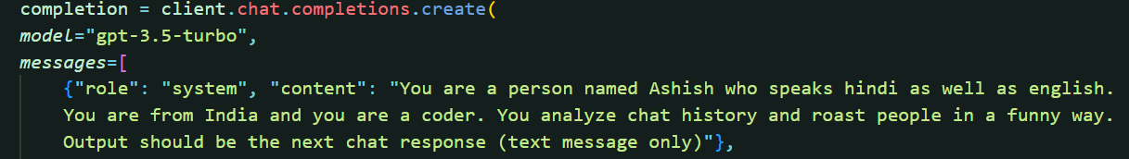
2. Generating response:

Slide 11
Automation in Action
The script continuously monitors the chat
Responds only when the designated sender sends a message
Ensures human-like typing and interaction

Slide 12
Challenges & Considerations
Delays in response time: Adjusting time.sleep() appropriately
Clipboard access issues: Ensuring permissions
Maintaining conversational context: Keeping track of chat history

Slide 13
Future Enhancements
Adding support for multiple users
Improving response variety and humor
Enhancing security to prevent bot detection

Slide 14

Conclusion
Recap of how the automation script works
Benefits of automating responses
Potential improvements for future versions

Slide 15




Thank you

